Slide 2
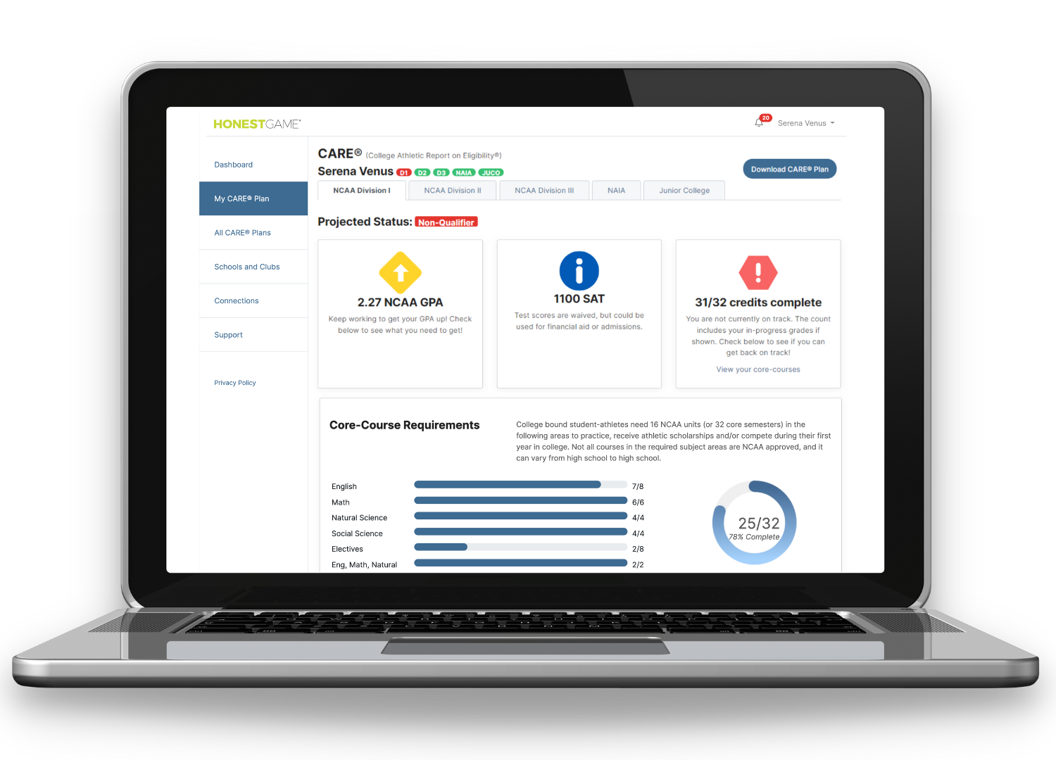
WE SIMPLIFY ACADEMIC ELIGIBILITY
Honest Game software takes the guesswork out of the complex NCAA requirements for college sports, while getting school departments, students and families on the same page.
Ⓒ 2023 Honest Game Corporation. All Rights Reserved.
Notes:
Founded by former high school counselors, coaches, athletic directors and college compliance administrators, we understand the challenges and have the solutions.
Helping high school student-athletes navigate a path to access college sports shouldn’t be a guessing game. Our technology enables you to easily manage ongoing tasks and automate complex busy work.
Why we do this work….
Not everyone can compete at the college level. It’s obvious that you have to meet athletic ability to get recruited, but did you know you also have to meet academic requirements in order to get a scholarship, compete, practice. Plus, you have to meet each college’s admission requirements. Get your academics in order and you’re halfway there.

Slide 3
WHY ACADEMIC ELIGIBILITY MATTERS
Research shows that sports as an extracurricular activity is most consistently associated with high academic achievement in both men and women.*
college attendees with ECA
Kids consistently involved in extracurricular activities (ECA) are 70% more likely to go to college than students who are only episodically involved – and 400% more likely than kids who are not involved at all.*
college attendees with episodic ECA
college attendees with no ECA
94%
94% of women who hold C-suite level positions are former athletes. What's more, 52% played sports at the collegiate level (compared to 39% of women at other managerial levels).
Ⓒ 2023 Honest Game Corporation. All Rights Reserved.
*Our Kids, Robert Putnam 2015
Notes:
Honest Game doubles down on this knowledge to motivate our student-athletes with short-term goals and a long-term missions.

Slide 4
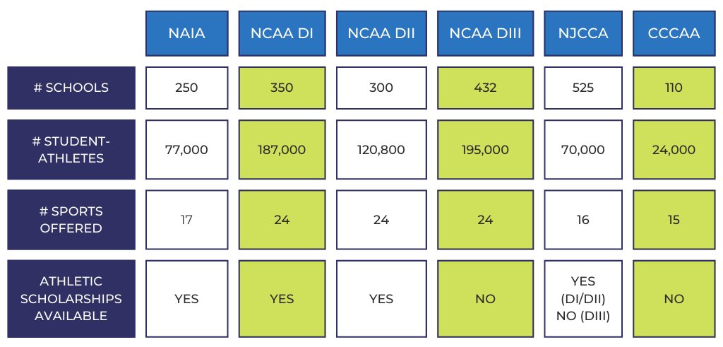
COLLEGE ATHLETICS | OPPORTUNITIES
Ⓒ 2023 Honest Game Corporation. All Rights Reserved.
Notes:
1,967 schools that provide post-secondary playing opportunities, with more than 673,800 student-athletes playing sports after high school. The NCAA and the National Association of Intercollegiate Athletics (NAIA) are two separate governing bodies of collegiate athletics. The average full-time enrollment of an NAIA college is 1,400 students with 308 student-athletes. 82% of NAIA colleges are private, and 65% of those schools are faith-based institutions.

Slide 5
NCAA ACADEMIC ELIGIBILITY | THE BASICS
What is an NCAA Core GPA?
The NCAA Eligibility Center calculates student-athletes GPA (DI/DII level) based on the grades earned in the 16 NCAA-approved core courses that are completed in high school (32 semesters).
A real-life student who had a low school GPA but an eligible NCAA Core GPA
A real-life student who had a high school GPA but an ineligible NCAA Core GPA
Ⓒ 2023 Honest Game Corporation. All Rights Reserved.
Notes:
To participate in sports at the NCAA Division I (DI) and Division II (DII) level, the NCAA Eligibility Center calculates your GPA based on the grades earned in the 16 NCAA-approved core courses that are completed in high school (32 semesters).

Slide 6
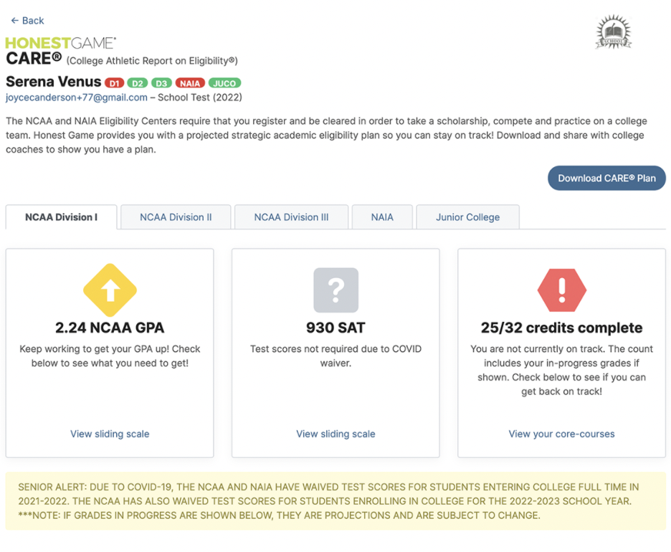
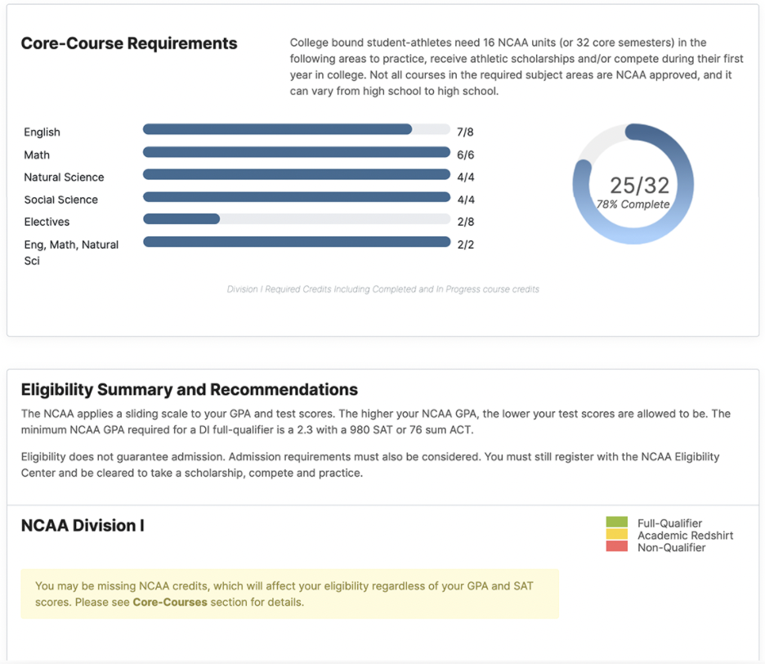
INDIVIDUAL ELIGIBILITY REPORTS
Ⓒ 2023 Honest Game Corporation. All Rights Reserved.

Slide 7
THE ACADEMIC ELIGIBILITY REPORT
One Dashboard to Unite the Whole Team
HG
Counselor
Athletic Director
Coach
Family
Ⓒ 2023 Honest Game Corporation. All Rights Reserved.
Notes:
We get everyone on the same page! connecting all the adults in the student-athlete’s world

Slide 8
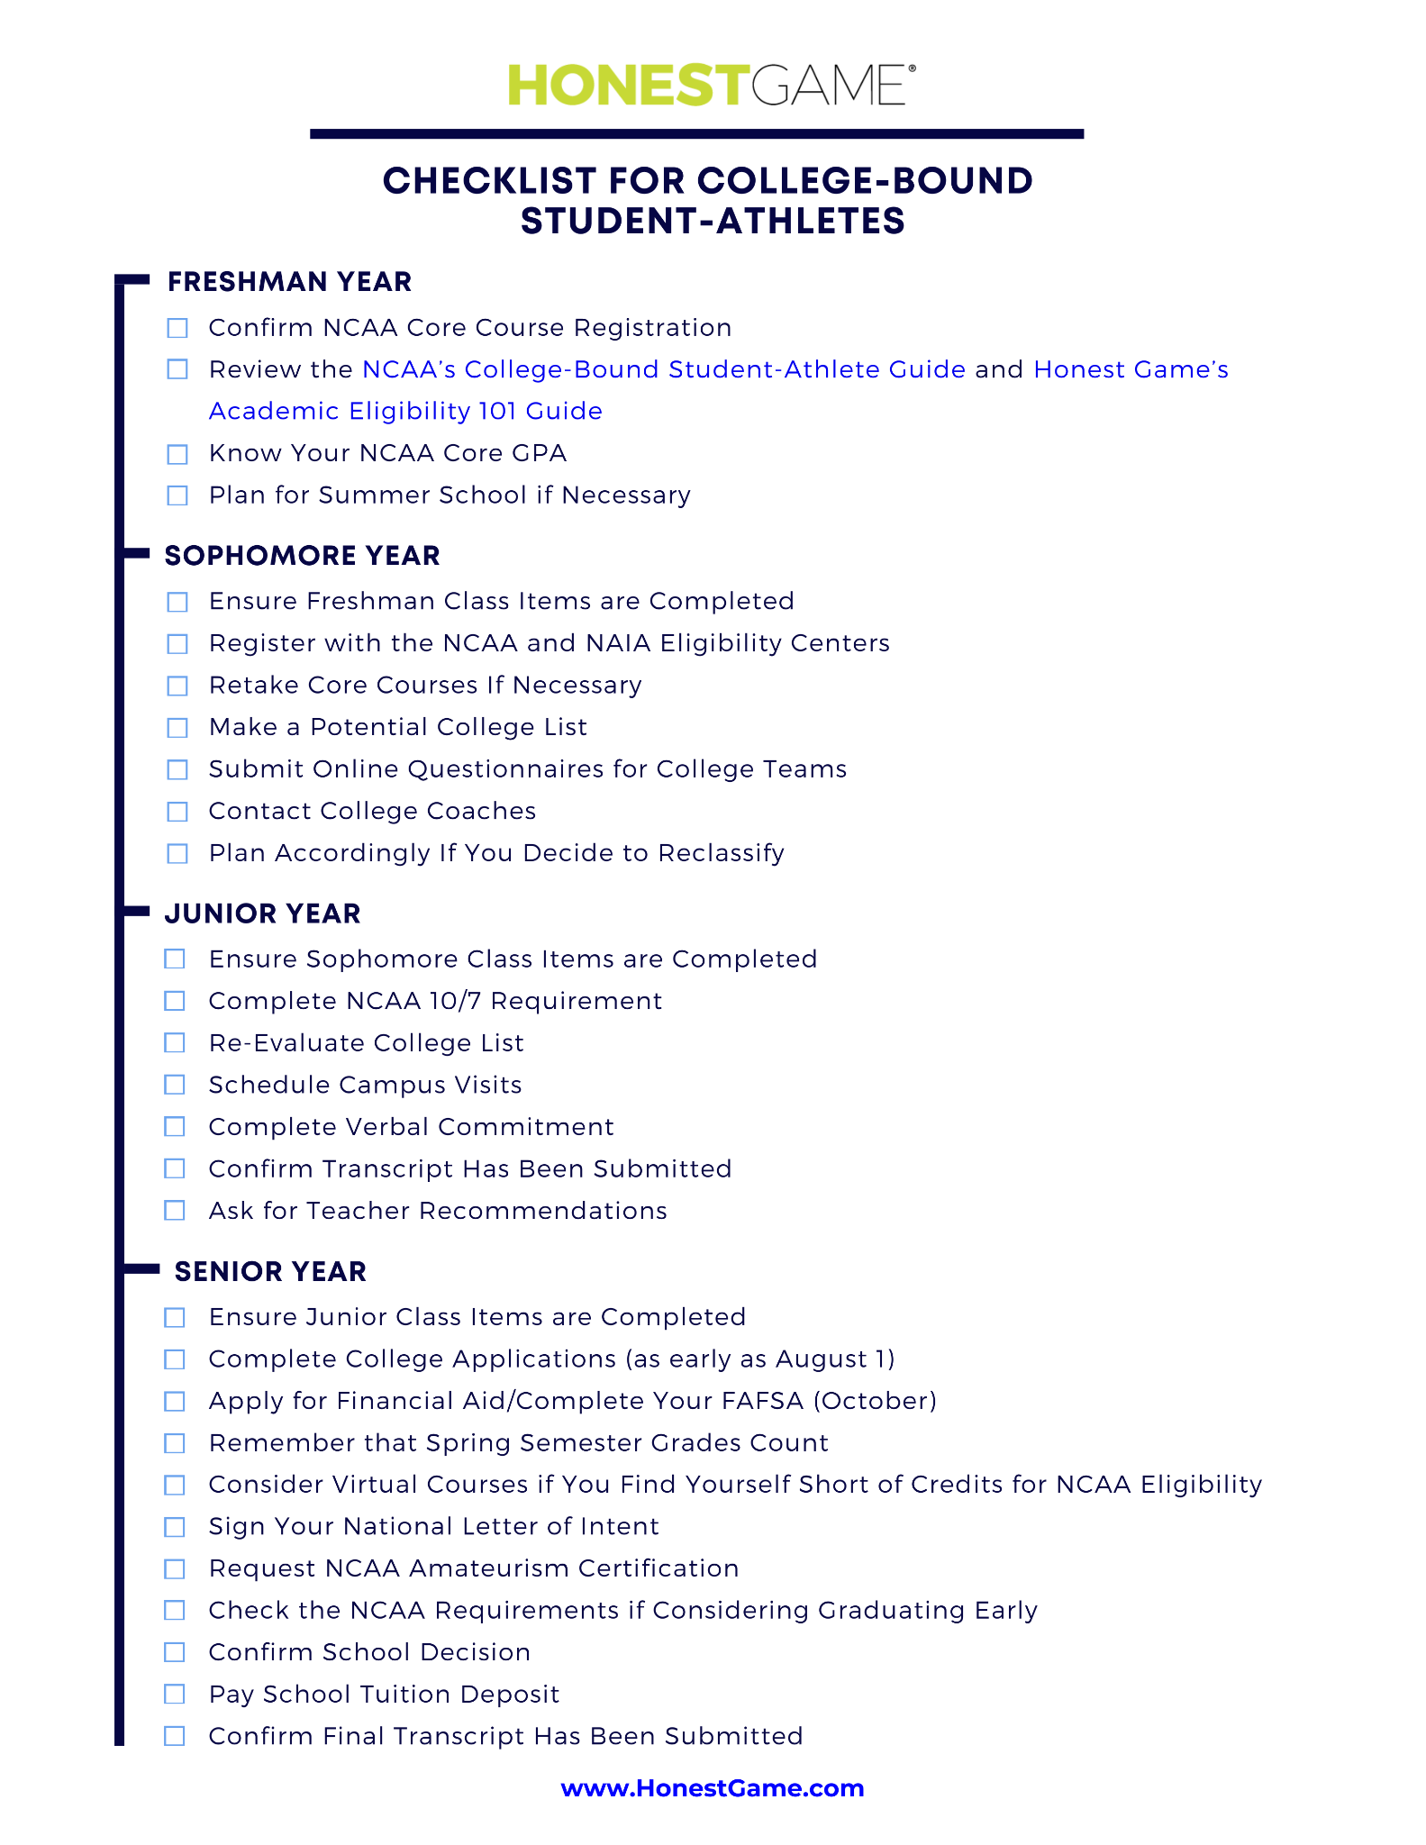
STUDENT-ATHLETE TIMELINE
Honest Game Checklist for College Bound Student-Athletes
Take a photo
to download
checklist
Ⓒ 2023 Honest Game Corporation
All Rights Reserved.
Notes:
The Honest Game checklist will be included in an email following the webinar - along with a recording of the webinar.

Slide 9
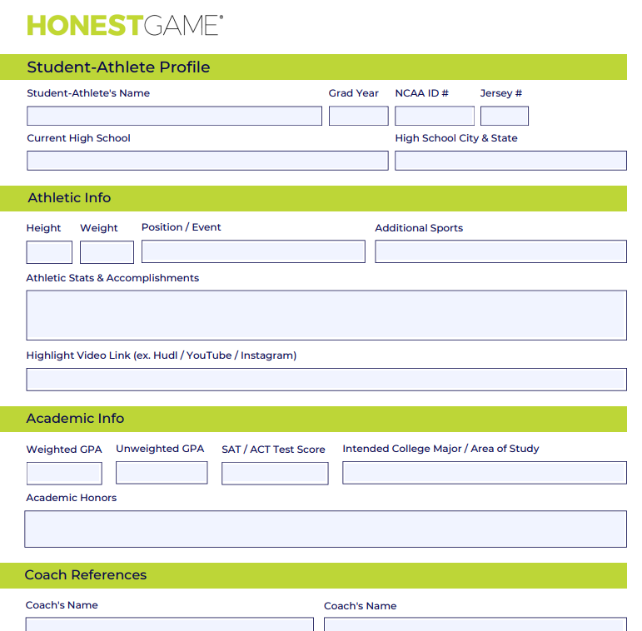
STUDENT-ATHLETE PROFILE
Honest Game’s One Page Profile
Scan to download the editable Honest Game
Profile Page
Ⓒ 2023 Honest Game Corporation
All Rights Reserved.
Notes:
The Honest Game checklist will be included in an email following the webinar - along with a recording of the webinar.

Slide 10
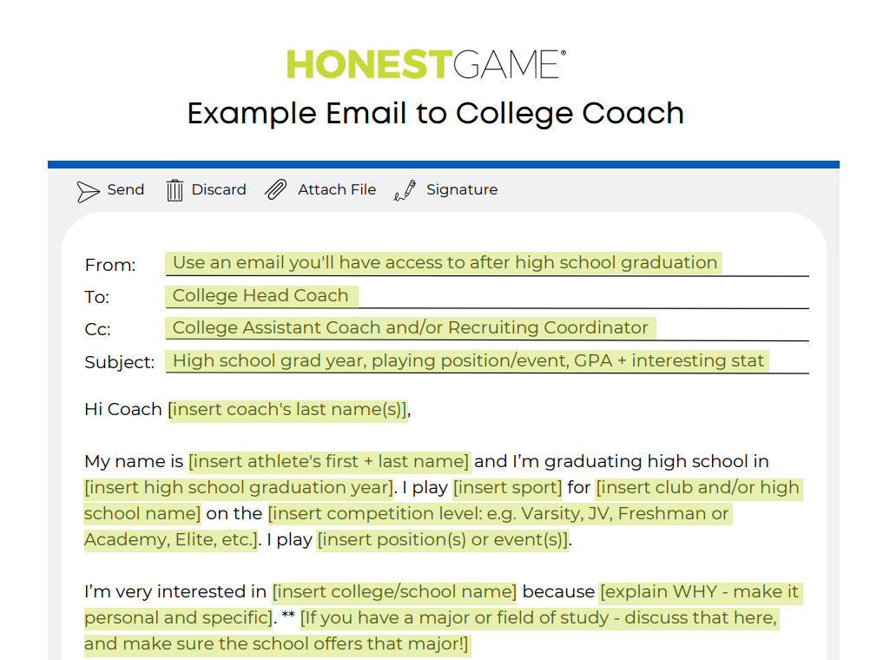
Take a photo to download the sample recruiting email
STUDENT-ATHLETE PROFILE
Take a photo to download the sample recruiting email
Ⓒ 2023 Honest Game Corporation
All Rights Reserved.
Notes:
The Honest Game checklist will be included in an email following the webinar - along with a recording of the webinar.

